Slide 1



Testing Web Services
with an Object-Oriented way
Vasilis PETROU | Test Automation Lead
2019 SEETEST Conference Bucharest

Slide 2
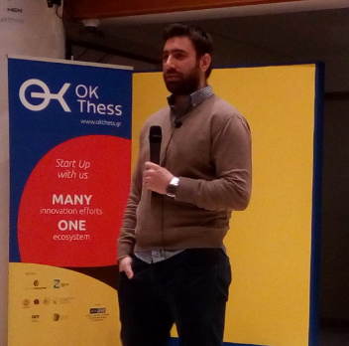
test automation lead at INTRASOFT International;
more than 11 years experience in full-stack development and more than 4 years in test automation;
co-organizer of Software Testing & QA Meetup Thessaloniki Greece;
volunteer organizer of lectures about Software Testing & Test Automation in Universities & Institutions.
Vasilis Petrou
“Knowledge is only real when shared”
Vasilis PETROU | Test Automation Lead | INTRASOFT International

Slide 3









established in 1996 in luxembourg, operations in 13 countries
#WeAreIntrasoft
a leading european IT solutions & services company
500+ organizations worldwide
have chosen our services
eu institutions
public sector
enterprise solutions
outstanding record
in over 70+ countries
around the globe
key player in
e.u. institutions and
agencies for 20+ years
headcount
2.000+ professionals
20+ nationalities
more than 25% growth
in revenue over
the past 2 years
47% university graduates
24% msc/phd holders
Vasilis PETROU | Test Automation Lead | INTRASOFT International

Slide 4

Load
Stress
API
independent Testing Team of INTRASOFT International
one of the biggest Testing Centers in Greece
more than 20 test engineers do automation
large number of implementations on the testing types included in the tree
Performance
Usability
Functional
GUI
Data Migration
Configuration
Non-Functional
Vasilis PETROU | Test Automation Lead | INTRASOFT International

Slide 5


































Azure
Devops
Vasilis PETROU | Test Automation Lead | INTRASOFT International

Slide 6
we will use
to test web services
Vasilis PETROU | Test Automation Lead | INTRASOFT International

Slide 7
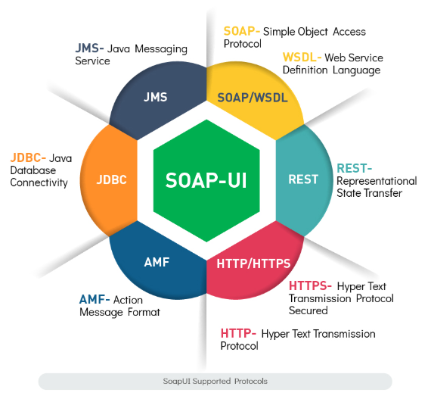
why SoapUI?
user-friendly GUI
easy for functional testing
automation with Apache Groovy
data-driven testing
assertions
it’s free!!!
SoapUI Open Source is a free for Commercial Use Software under the terms of European Union Public License (EUPL V.1.1).
Vasilis PETROU | Test Automation Lead | INTRASOFT International

Slide 8
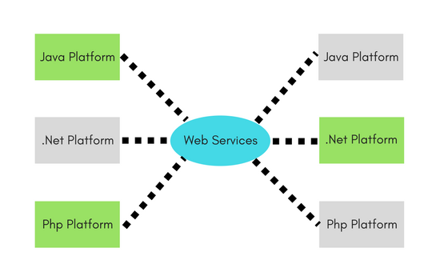
what are web services?
web service is a software system designed to support
machine-to-machine interaction over a network.
- W3C -
Vasilis PETROU | Test Automation Lead | INTRASOFT International

Slide 9

what are the types of web services?
SOAP & REST Web Services
Vasilis PETROU | Test Automation Lead | INTRASOFT International

Slide 10
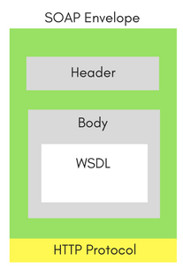
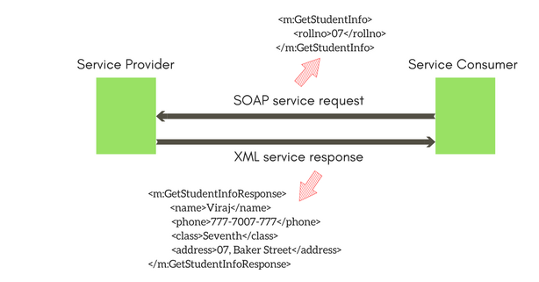
what are the SOAP Web Services?
Simple Object Access Protocol (SOAP) is an XML-based protocol.
the biggest advantage of using the SOAP Web Service is its own security.
SOAP provides an envelope to send a web services messages over the Internet, using the HTTP protocol.
Vasilis PETROU | Test Automation Lead | INTRASOFT International

Slide 11
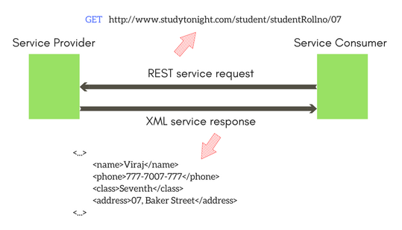
what are the REST Web Services?
Representational State Transfer (REST) is a style of software architecture
for creating web services using predefined operations GET POST PUT DELETE.
Vasilis PETROU | Test Automation Lead | INTRASOFT International

Slide 12

let’s start practice
to automate web service tests
Vasilis PETROU | Test Automation Lead | INTRASOFT International

Slide 13

but first, what do we need?
of course, a web service
Vasilis PETROU | Test Automation Lead | INTRASOFT International

Slide 14
step 1
prepare to build a Web Service Application
assuming that we work on a Windows OS machine, next steps should be followed to build an indicative Web Service Application
Vasilis PETROU | Test Automation Lead | INTRASOFT International

Slide 15
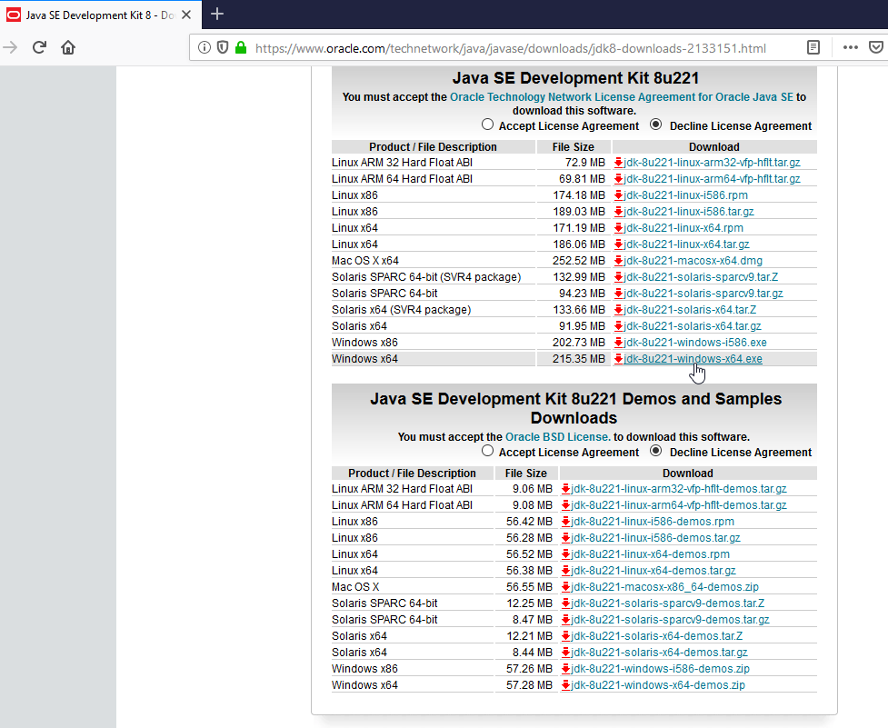
step 1. prepare to build a Web Service Application (1 of 5)
download and Install JAVA 8
https://www.oracle.com/technetwork/java/javase/downloads/jdk8-downloads-2133151.html
* don’t forget to set JAVA_HOME environment variable
Vasilis PETROU | Test Automation Lead | INTRASOFT International

Slide 16
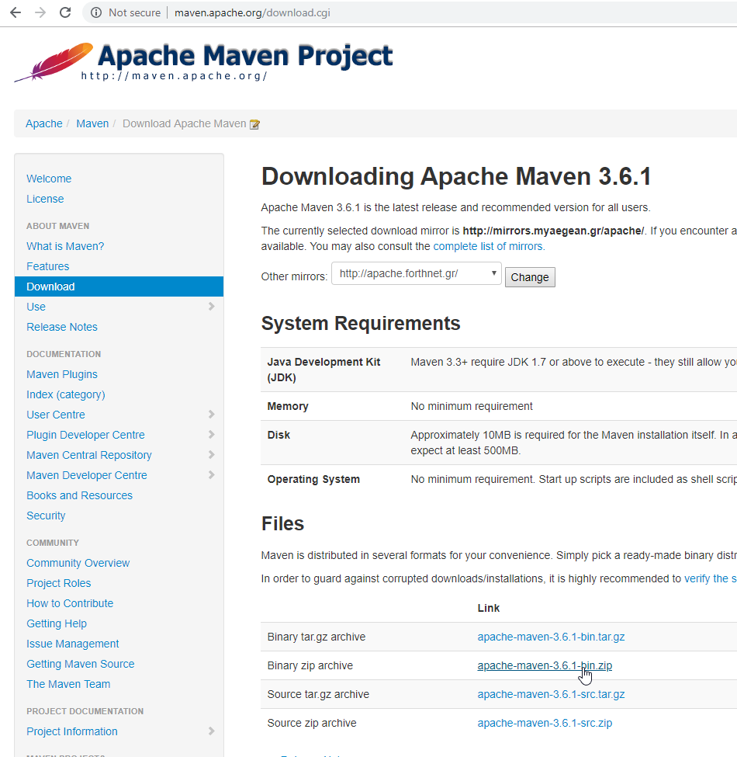
step 1. prepare to build a Web Service Application (2 of 5)
download and Install Maven
http://maven.apache.org/download.cgi
* don’t forget to set MAVEN_HOME environment variable
Vasilis PETROU | Test Automation Lead | INTRASOFT International

Slide 17
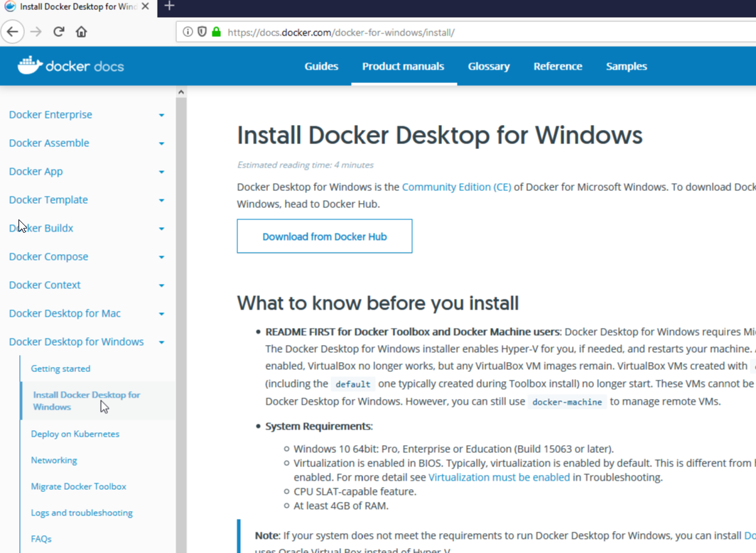
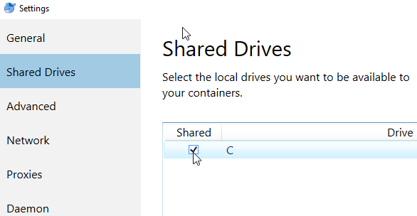
step 1. prepare to build a Web Service Application (3 of 5)
download and Install Docker for Windows
https://docs.docker.com/docker-for-windows/install/
* don’t forget to update settings and share your drive.
Vasilis PETROU | Test Automation Lead | INTRASOFT International

Slide 18
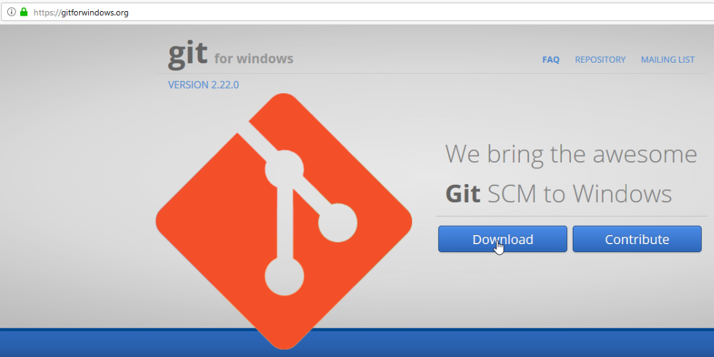
step 1. prepare to build a Web Service Application (4 of 5)
download and Install
GIT for Windows
https://gitforwindows.org/
Vasilis PETROU | Test Automation Lead | INTRASOFT International

Slide 19
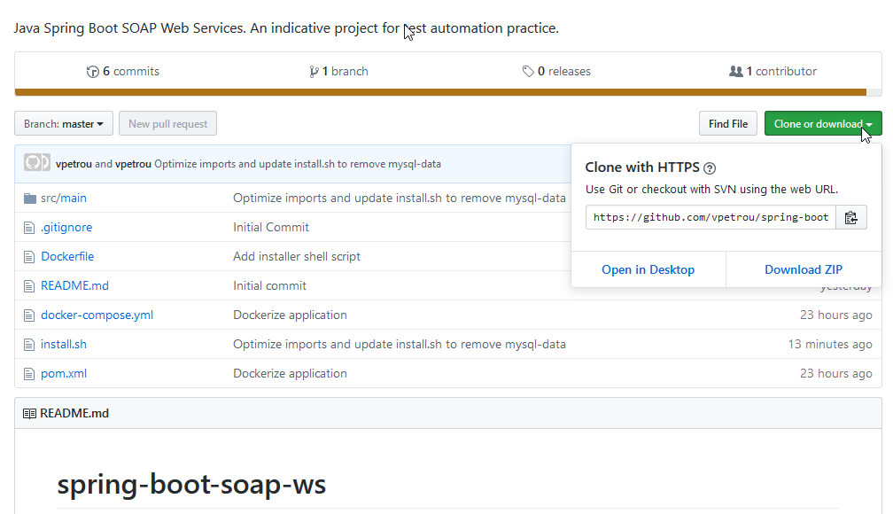
step 1. prepare to build a Web Service Application (5 of 5)
download
an indicative Web Service Application
from my GIT Repo
https://github.com/vpetrou/spring-boot-soap-ws
* the Web Service Application is written in JAVA Spring Boot with MySQL DB
Vasilis PETROU | Test Automation Lead | INTRASOFT International

Slide 20
step 2
build the indicative Web Service Application
Vasilis PETROU | Test Automation Lead | INTRASOFT International

Slide 21
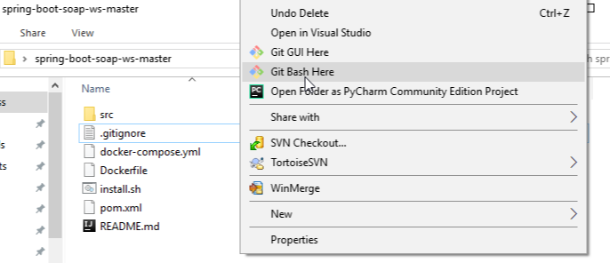
step 2. build the indicative Web Service Application (1 of 3)
right click on the folder with the indicative Web Service Application and select
GIT Bash here
Vasilis PETROU | Test Automation Lead | INTRASOFT International

Slide 22
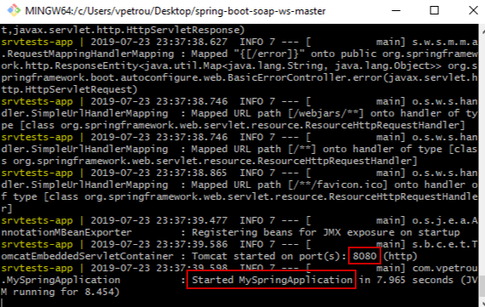
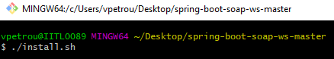
step 2. build the indicative Web Service Application (2 of 3)
from the Git Bash window, execute the command:
./install.sh
and wait until the application is started.
* ports 8080 and 3306 are used by the Docker Containers
Vasilis PETROU | Test Automation Lead | INTRASOFT International

Slide 23
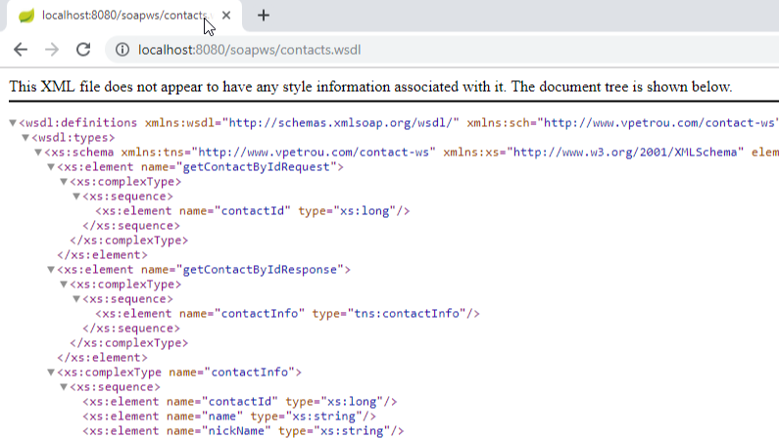
step 2. build the indicative Web Service Application (3 of 3)
visit URL:
http://localhost:8080/soapws/contacts.wsdl
to verify that Web Service is Up & Running.
the Web Services Description Language (WSDL) is an XML-based interface description language that is used for describing the functionality offered by a web service.
Vasilis PETROU | Test Automation Lead | INTRASOFT International

Slide 24
step 3
analyze the Web Service under Test
Vasilis PETROU | Test Automation Lead | INTRASOFT International

Slide 25
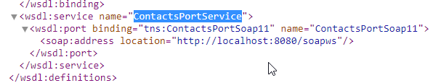
step 3. analyze the Web Service under Test (1 of 5)
the name of the web service is ContactsPortService
this service contains CRUD service operations
* definition of CRUD: Create Read Update Delete
Vasilis PETROU | Test Automation Lead | INTRASOFT International

Slide 26
step 3. analyze the Web Service under Test (2 of 5)
available Service Operations of ContactsPortService:
addContact: to add a new contact;
updateContact: to update a contact;
deleteContact: to delete a contact;
getAllContacts: to get a list of all contacts;
getContactById: to get a contact by Id;
getContactByName: to get all contacts that contain all or part of given name.
Vasilis PETROU | Test Automation Lead | INTRASOFT International

Slide 27
step 3. analyze the Web Service under Test (3 of 5)
columns of table Contact:
contactId: numeric(1..5), Key, Auto Increment;
name: Not Null, Alphanumeric(1..30);
nickName: Alphanumeric(8), Pattern (4 letters and 4 numbers)
category: Alphanumeric(0..30)
phone: Numeric(0..14)
email: Alphanumeric(0..30), Email Pattern (…@...)
city: Alphanumeric(0..30)
country: Alphanumeric(0..30)
Vasilis PETROU | Test Automation Lead | INTRASOFT International

Slide 28
step 3. analyze the Web Service under Test (4 of 5)
proof of concept (PoC):
We will create some indicative test cases for the “addContact” service operation.
Each Test Case will contain a groovy step to generate a random “nickName” with the accepted pattern “4 letters and 4 numbers”.
After the implementation, a request for change will be handled to check the maintenance effort. This request for change will be related with the column “nickName” where the pattern changes to “4 letters and 6 numbers”.
The maintenance effort between the 2 different implementation methodologies in SoapUI will be compared.
Vasilis PETROU | Test Automation Lead | INTRASOFT International

Slide 29
step 3. analyze the Web Service under Test (5 of 5)
indicative Test Cases for the test suite TS-SRV-AddContacts :
TC-SRV-AddContacts-P-001: Tests the addition of a contact where all the fields are inserted with valid value.
TC-SRV-AddContacts-N-001: Tests the addition of a contact where all the fields are inserted with valid value except field ‘email’ which has invalid value.
TC-SRV-AddContacts-N-002: Tests the addition of a contact where all the fields are inserted with valid value except field ‘phone’ which has invalid value.
TC-SRV-AddContacts-N-003: Tests the addition of a contact where all the fields are inserted with valid value except field ‘nickName’ which has invalid value.
* naming convention of Test Case ID: TC = Test Case, SRV = Services, AddContacts = Service Operation, P = Positive or N = Negative, 001 = Serial Number
Vasilis PETROU | Test Automation Lead | INTRASOFT International

Slide 30
step 4
prepare to build Web Service Test Scripts
Vasilis PETROU | Test Automation Lead | INTRASOFT International

Slide 31
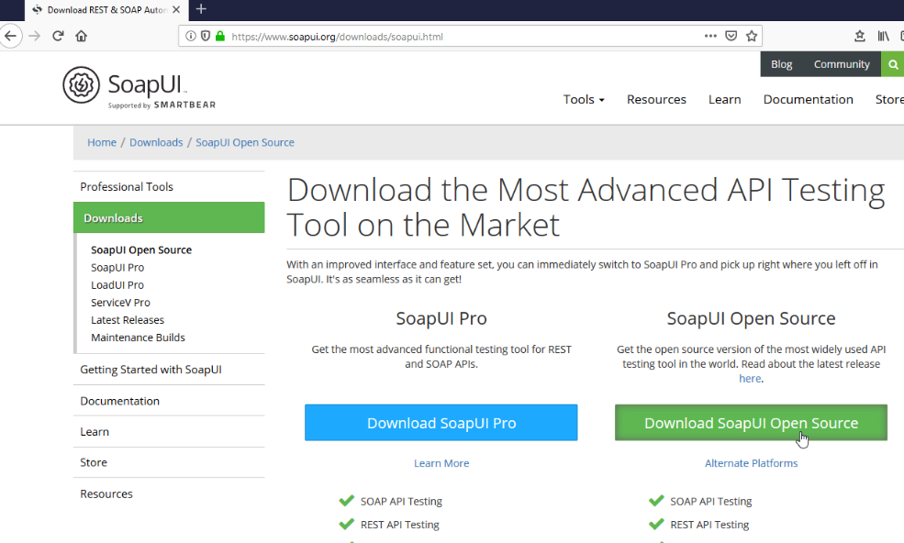
step 4. prepare to build Web Service Test Scripts
download and Install
SoapUI Open Source
https://www.soapui.org/downloads/soapui.html
Vasilis PETROU | Test Automation Lead | INTRASOFT International

Slide 32
step 5
build Web Service Test Scripts via SoapUI
with the common way
Vasilis PETROU | Test Automation Lead | INTRASOFT International

Slide 33
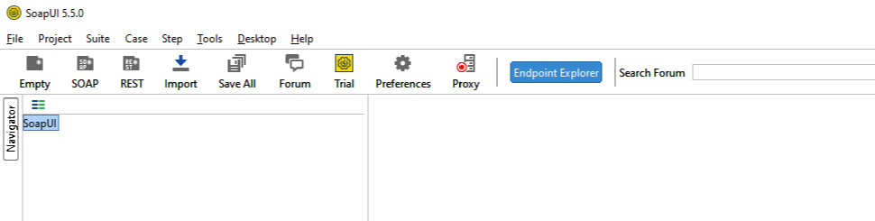
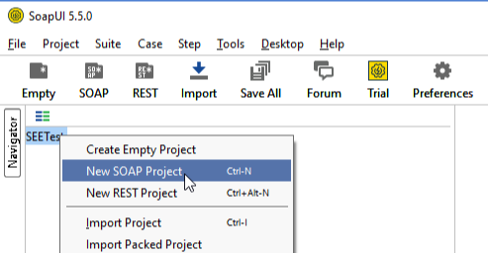
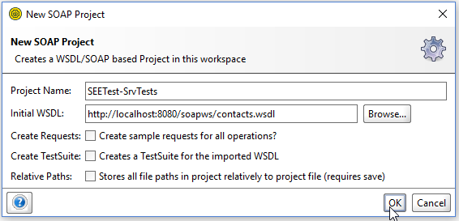
step 5. build Web Service Test Scripts via SoapUI with the common way (1 of 16)
open SoapUI Open Source
and start a new project (e.g. SEETest-SrvTests) selecting “New SOAP Project”
Vasilis PETROU | Test Automation Lead | INTRASOFT International

Slide 34
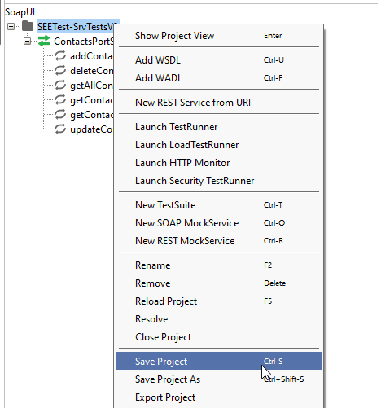
step 5. build Web Service Test Scripts via SoapUI with the common way (2 of 16)
before proceeding with test cases, select “Save Project”
* it is not mandatory to save the project at the beginning. It is just a suggestion in order not to forget to save it before exiting.
Vasilis PETROU | Test Automation Lead | INTRASOFT International

Slide 35
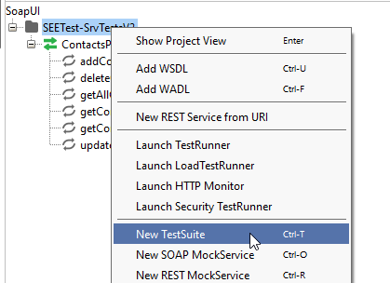
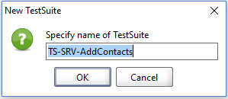
step 5. build Web Service Test Scripts via SoapUI with the common way (3 of 16)
right click on SoapUI Project and select option “New TestSuite”
then specify the name “TS-SRV-AddContacts” for the new test suite.
Vasilis PETROU | Test Automation Lead | INTRASOFT International

Slide 36
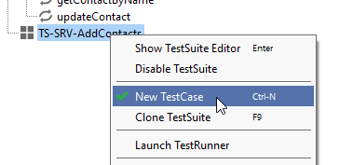
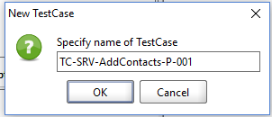
step 5. build Web Service Test Scripts via SoapUI with the common way (4 of 16)
right click on Test Suite “TS-SRV-AddContacts” and select option “New TestCase”
then specify the name “TC-SRV-AddContacts-P-001” for the new test case.
Vasilis PETROU | Test Automation Lead | INTRASOFT International

Slide 37
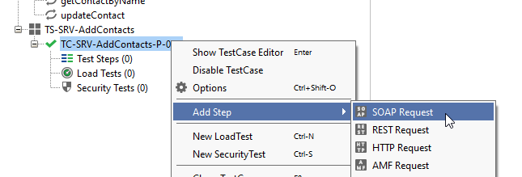
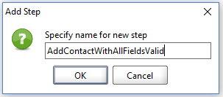
step 5. build Web Service Test Scripts via SoapUI with the common way (5 of 16)
right click on Test Case “TC-SRV-AddContacts-P-001” and select option “Add Step” and “Soap Request”
then specify the name “AddContactWithAllFieldsValid” for the new step.
Vasilis PETROU | Test Automation Lead | INTRASOFT International

Slide 38
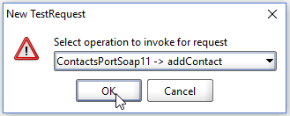
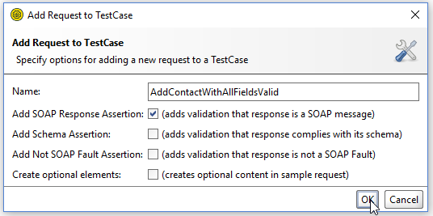
step 5. build Web Service Test Scripts via SoapUI with the common way (6 of 16)
specify the service operation “addContact” to invoke for the request.
specify additional options for the new step (e.g. “Add SOAP Response Assertion” to be checked).
Vasilis PETROU | Test Automation Lead | INTRASOFT International

Slide 39
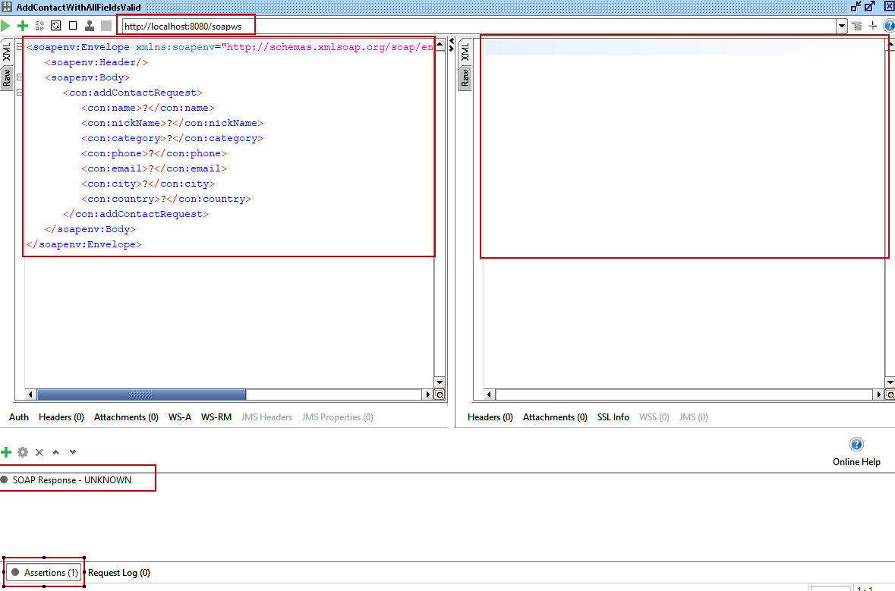
step 5. build Web Service Test Scripts via SoapUI with the common way (7 of 16)
Vasilis PETROU | Test Automation Lead | INTRASOFT International

Slide 40
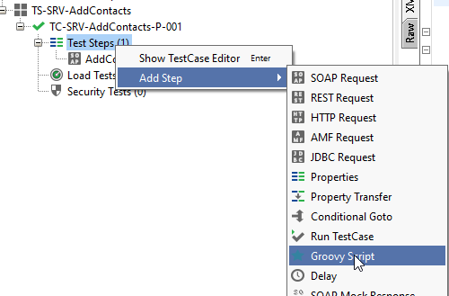
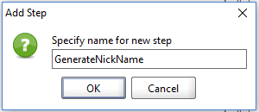
step 5. build Web Service Test Scripts via SoapUI with the common way (8 of 16)
create a groovy step to generate a nickname
right click on Test Case “TC-SRV-AddContacts-P-001” and select option “Add Step” and “Groovy Script”
then specify the name “GenerateNickName” for the new step.
Vasilis PETROU | Test Automation Lead | INTRASOFT International

Slide 41
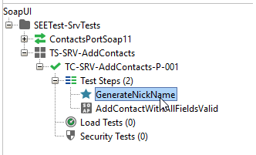
step 5. build Web Service Test Scripts via SoapUI with the common way (9 of 16)
drag ‘n drop step ‘GenerateNickName’ to be first in the list of steps of test case “TC-SRV-AddContacts-P-001”
Vasilis PETROU | Test Automation Lead | INTRASOFT International

Slide 42
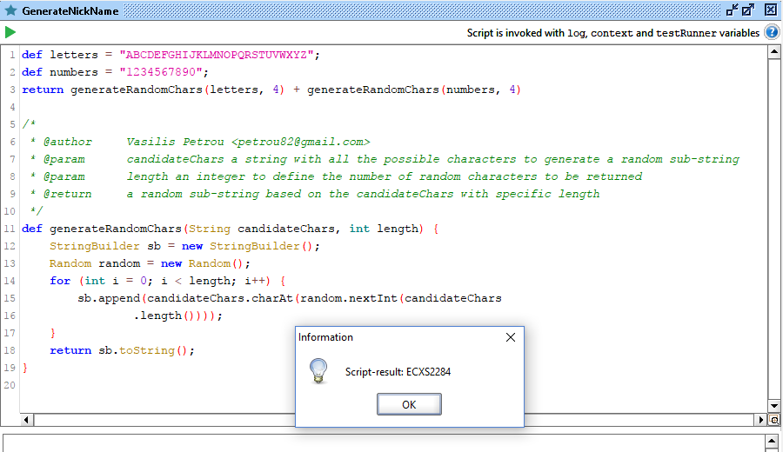
step 5. build Web Service Test Scripts via SoapUI with the common way (10 of 16)
step ‘GenerateNickName’ returns a random string with 4 letters and 4 numbers:
* this groovy step is indicative, just for demonstration reasons.
Vasilis PETROU | Test Automation Lead | INTRASOFT International

Slide 43
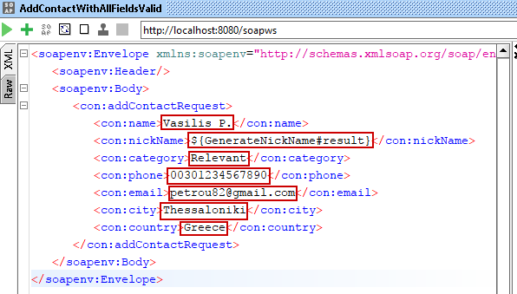
step 5. build Web Service Test Scripts via SoapUI with the common way (11 of 16)
now, we will insert values in all fields of step ‘AddContactWithAllFieldsValid’:
* ${GenerateNickName#result} returns the result of groovy step GenerateNickName
Vasilis PETROU | Test Automation Lead | INTRASOFT International

Slide 44
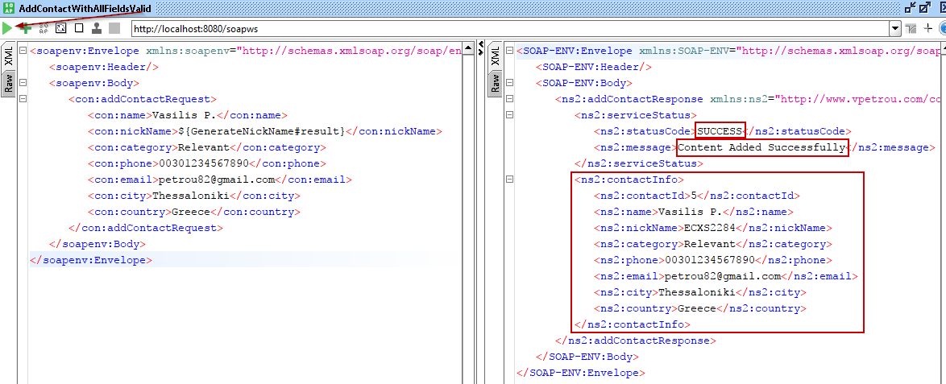
step 5. build Web Service Test Scripts via SoapUI with the common way (12 of 16)
running step ‘AddContactWithAllFieldsValid’ we will see a response with SUCCESS status code:
Vasilis PETROU | Test Automation Lead | INTRASOFT International

Slide 45
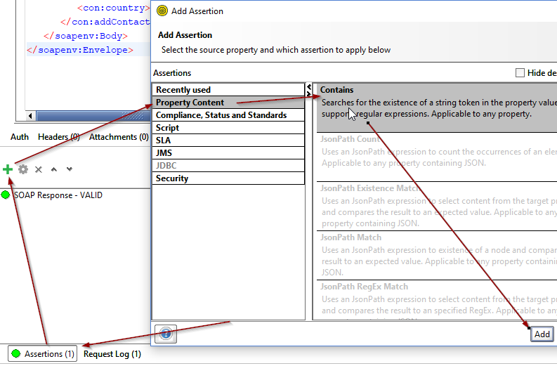
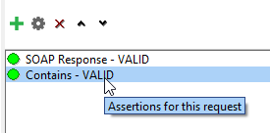
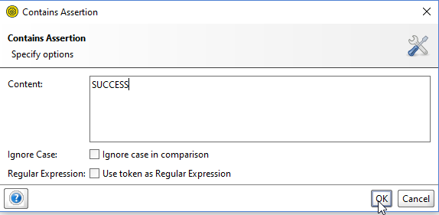
step 5. build Web Service Test Scripts via SoapUI with the common way (13 of 16)
add an assertion to step ‘AddContactWithAllFieldsValid’ to verify that response contains the word “SUCCESS”:
Vasilis PETROU | Test Automation Lead | INTRASOFT International

Slide 46
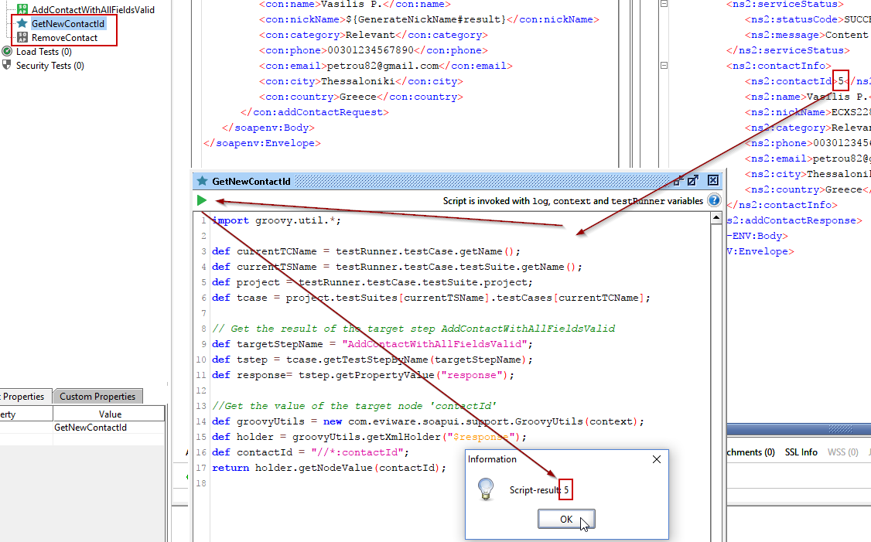
step 5. build Web Service Test Scripts via SoapUI with the common way (14 of 16)
finally to be able to run and re-run the same test case insert the appropriate steps to get the new generated contact ID and remove the contact.
Vasilis PETROU | Test Automation Lead | INTRASOFT International

Slide 47
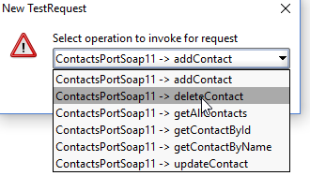
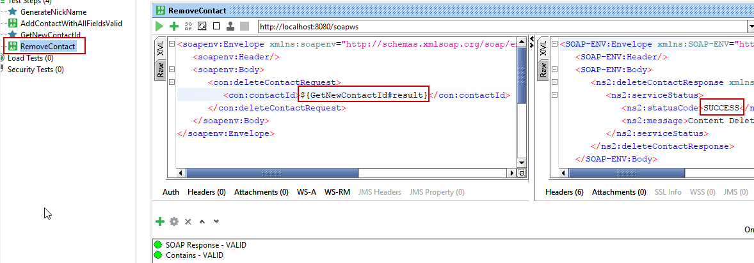
step 5. build Web Service Test Scripts via SoapUI with the common way (15 of 16)
after we get the new generated contact ID via a Groovy step, we can use it in a next Soap Request step to remove the Contact.
Vasilis PETROU | Test Automation Lead | INTRASOFT International

Slide 48
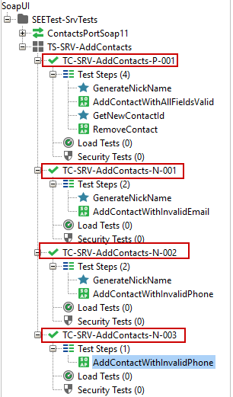
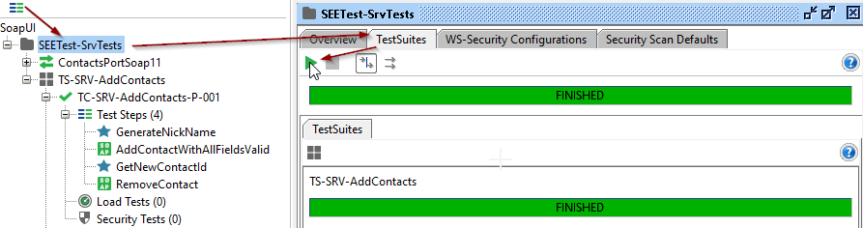
step 5. build Web Service Test Scripts via SoapUI with the common way (16 of 16)
repeat above steps (or clone) to implement the rest test cases.
A full run proves that tests work properly.
* test case TC-SRV-AddContacts-N-003 will be the only one that will not contain groovy step “GenerateNickName”.
Vasilis PETROU | Test Automation Lead | INTRASOFT International

Slide 49
step 6
build Web Service Test Scripts via SoapUI
with the object oriented way
Vasilis PETROU | Test Automation Lead | INTRASOFT International

Slide 50
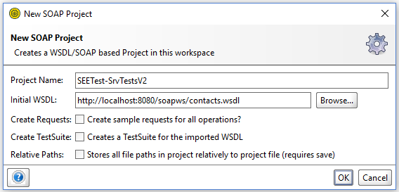
step 6. build Web Service Test Scripts via SoapUI with the object oriented way (1 of 8)
open SoapUI Open Source
and start a new project (e.g. SEETest-SrvTestsV2) selecting “New SOAP Project”
Vasilis PETROU | Test Automation Lead | INTRASOFT International

Slide 51
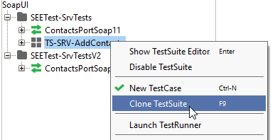
step 6. build Web Service Test Scripts via SoapUI with the object oriented way (2 of 8)
before proceeding with test cases, select “Save Project”
to avoid the re-creation of test cases just right click and select “Clone TestSuite” to clone test suite of SEETest-SrvTests to SEETest-SrvTestsV2
Vasilis PETROU | Test Automation Lead | INTRASOFT International

Slide 52
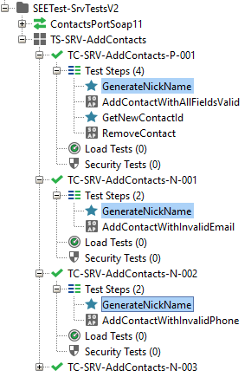
step 6. build Web Service Test Scripts via SoapUI with the object oriented way (3 of 8)
step “GenerateNickName” of test cases
TC-SRV-AddContacts-P-001
TC-SRV-AddContacts-N-001
TC-SRV-AddContacts-N-002
will be updated with the use of
External Groovy Script
Vasilis PETROU | Test Automation Lead | INTRASOFT International

Slide 53
step 6. build Web Service Test Scripts via SoapUI with the object oriented way (4 of 8)
why to use External Groovy Script?
implementation of repeated steps will be handled from a single point.
so, if an update affects these steps, the effort to update them is almost nothing in relation to the effort it takes to update all the affected steps one by one.
Vasilis PETROU | Test Automation Lead | INTRASOFT International

Slide 54
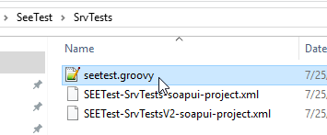
step 6. build Web Service Test Scripts via SoapUI with the object oriented way (5 of 8)
in the same folder with the SoapUI project (SEETest-SrvTestsV2-soapui-project.xml) create a file with name “seetest.groovy”
copy-paste the content of Groovy Step “GenerateNickName” to External Groovy Script “seetest.groovy”
Vasilis PETROU | Test Automation Lead | INTRASOFT International

Slide 55
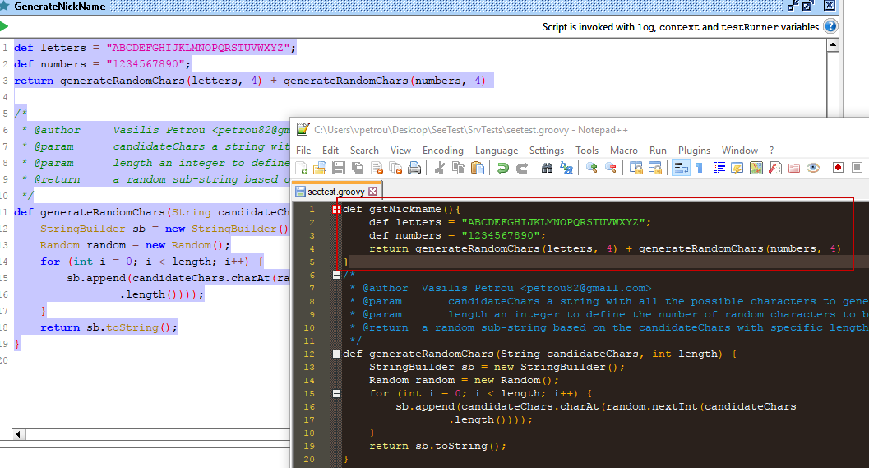
step 6. build Web Service Test Scripts via SoapUI with the object oriented way (6 of 8)
method “getNickname()” returns an auto-generated nickname based on pattern (4 letters + 4 numbers)
Vasilis PETROU | Test Automation Lead | INTRASOFT International

Slide 56

step 6. build Web Service Test Scripts via SoapUI with the object oriented way (7 of 8)
in SoapUI Project update groovy Step “GenerateNickName” (for all test cases) to call method “getNickname()” from the External Groovy Script “seetest.groovy”
* above implementation is based on GroovyScriptEngine: http://docs.groovy-lang.org/latest/html/api/groovy/util/GroovyScriptEngine.html
Vasilis PETROU | Test Automation Lead | INTRASOFT International

Slide 57

step 6. build Web Service Test Scripts via SoapUI with the object oriented way (8 of 8)
the implementation of method “getNickname()” is now out of SoapUI which means that any change about how the nickname should be, will affect only External Groovy Script “seetest.groovy”.
a full run proves that tests work properly.
Vasilis PETROU | Test Automation Lead | INTRASOFT International

Slide 58
step 7
update Web Service Test Scripts
based on Request for Change (RfC)
Vasilis PETROU | Test Automation Lead | INTRASOFT International

Slide 59
step 7. update Web Service Test Scripts based on Request for Change (RfC) (1 of 4)
so, in a next release of the application, our customer decided to request a change regarding the nickname.
the pattern must change
from “4 letters and 4 numbers”
to “4 letters and 6 numbers”.
Vasilis PETROU | Test Automation Lead | INTRASOFT International

Slide 60
step 7. update Web Service Test Scripts based on Request for Change (RfC) (2 of 4)
based on the 2 different implementation methodologies in SoapUI (step 5 & step 6), below is displayed a table of affections:
 | Common Methodology | Object Oriented Methodology
Affected Test Steps in SoapUI | 3 | 0
Affected External Groovy Scripts | 0 | 1
Vasilis PETROU | Test Automation Lead | INTRASOFT International

Slide 61

step 7. update Web Service Test Scripts based on Request for Change (RfC) (3 of 4)
based on common methodology each “GenerateNickName” must be updated in SoapUI.
in this demo project effort seems to be low, but when we are talking about hundreds of affected test cases and when the update is not such simple allowing us to make a simple Search-Replace in the SoapUI Project XML file, then maintenance is a real bottleneck.
Vasilis PETROU | Test Automation Lead | INTRASOFT International

Slide 62

step 7. update Web Service Test Scripts based on Request for Change (RfC) (4 of 4)
based on object oriented methodology nothing should be updated in SoapUI. Only method “getNickname()” of the external groovy script “seetest.groovy” must be updated properly.
the fact that the effort relates to only one point outside SoapUI makes not only maintenance easier in terms of the needed actions but also in terms of guidelines. When we deliver a SoapUI project and something goes wrong it is easier to suggest workarounds by simply editing content of groovy files than giving workarounds with actions inside SoapUI steps.
Vasilis PETROU | Test Automation Lead | INTRASOFT International

Slide 63

in conclusion (1 of 3)
there is a minor disadvantage of using External Groovy Scripts:
when a part of external groovy method has failure, we must work with 2 different environments. Meaning that the script can be opened e.g. with Notepad++ (it cannot be opened via SoapUI directly to quickly edit the script and proceed.
tip: we usually work with external groovy files via IntelliJ Community Edition having installed the Groovy SDK. http://groovy-lang.org/download.html there we can run and debug groovy scripts and find easier all the needed “imports”.
Vasilis PETROU | Test Automation Lead | INTRASOFT International

Slide 64

in conclusion (2 of 3)
the advantage of the easier maintenance and the external handling is such significant that makes the selection of this methodology a real need.
and after this easier maintenance, we feel like…
MVPs
Vasilis PETROU | Test Automation Lead | INTRASOFT International

Slide 65
in conclusion (3 of 3)
of course, there are applications, where the number of test cases is not large, or the resources (test engineers) have not the necessary skills.
there is no right or wrong
based on the project’s needs…
the decision is yours to make
Vasilis PETROU | Test Automation Lead | INTRASOFT International

Slide 66

where to find the SoapUI Projects?
GitHub:
https://github.com/vpetrou/srv-tests-soapui
Vasilis PETROU | Test Automation Lead | INTRASOFT International

Slide 67
where to find me?
my GitHub:
https://github.com/vpetrou
my LinkedIn Profile:
https://www.linkedin.com/in/vasilis-petrou-09a785a3/
my Emails:
vasilios.petrou@intrasoft-intl.com
petrou82@gmail.com
Vasilis PETROU | Test Automation Lead | INTRASOFT International

Slide 68
thank you
questions?
Vasilis PETROU | Test Automation Lead | INTRASOFT International

